Slide 1

Information Technology
Certified Project
Monthly Reports
Department of Information Technology
Enterprise Project Management Office
(EPMO)
April 2023

Slide 2
Topics
Criteria for Information Technology (IT) Project Certification
Certifying a Project
Monthly Reports
  Project Base Information
  Project Schedule Status
  Project Budget
  Contact Information
  Project Milestones
New Mexico Department of Information Technology

Slide 3
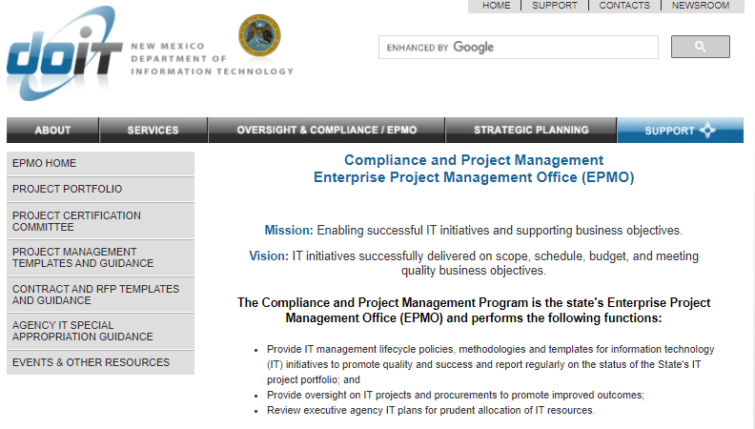
New Mexico Department of Information Technology

Slide 4
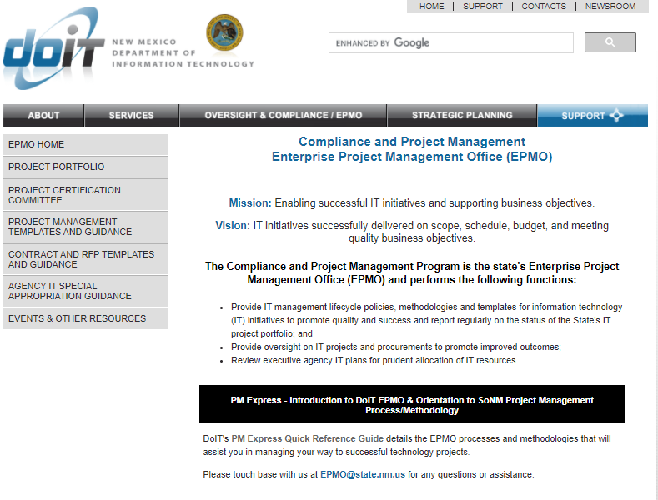
New Mexico Department of Information Technology

Slide 5
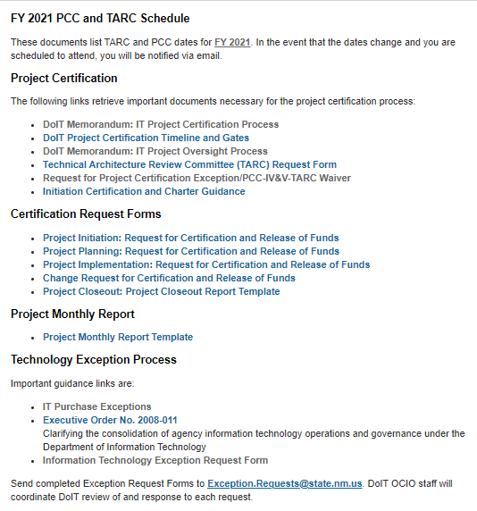
New Mexico Department of Information Technology

Slide 6
I. Criteria for IT Project Certification
IT project certification memo in the Project Certification section at http://www.doit.state.nm.us/oversight.html, labeled DoIT Memorandum: IT Project Certification Process.
Outlines the process and requirement for IT project certification for executive branch agencies as required under the Department of Information Technology (DoIT) Act.
All executive branch agency IT projects must follow the certification process in order for IT project funds to be released, regardless of the source of those funds.

Slide 7
I. Criteria for IT Project Certification
Project is required to undergo phased certifications as a result of the appropriation;
Project is a subsequent or interrelated project to a previously certified project;
Project cost is equal to or in excess of $100,000;
Project is one deemed appropriate by the Secretary of the DoIT.
If the project meets this criteria, but you consider the project one that can be justified as a low-risk project, you may complete a Request for Project Certification Exception or Waiver for consideration by the Department of Information Technology.
The form can be found at New Mexico Department of Information Technology - Project Oversight & Compliance Division (state.nm.us) in the Project Certification section, labeled Request for Project Certification Exception/PCC-IV&V-TARC Waiver.

Slide 8
II. Certifying a Project
Once you realize that a project meets one of the criteria for project certification or if you are considering a Request for Project Certification Exception or Waiver Request, contact EPMO at epmo@state.nm.us.
Your assigned EPMO project manager will discuss your project with you and determine if you are ready for certification.
The FY 2021 PCC and TARC schedule is posted at http://www.doit.state.nm.us/oversight.html in the FY 2021 PCC and TARC Schedule section.
The schedule lists dates for document submission and meetings.

Slide 9
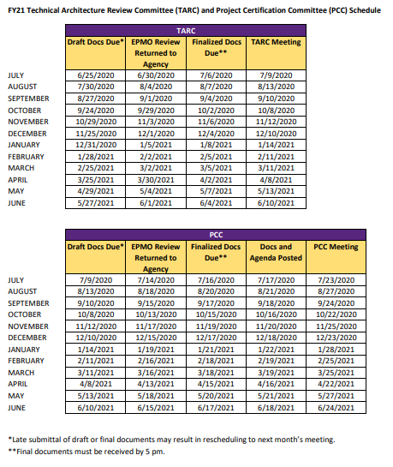
II. Certifying a Project

Slide 10
III. Monthly Reports
Once a project is initiated, the assigned project manager reports on the status of the project’s key project indicators (KPI) on a monthly basis beginning the month after the project initiation date through project closeout.
Reports are due on the 10th of each month reporting on activities of the prior month.
The monthly report template can be found at http://www.doit.state.nm.us/oversight.html in the Project Monthly Report section.
Sheet One is the overall monthly status of project and KPIs.
Sheet Two is a detailed breakdown of milestones and progress.
Email the completed report to EPMO@state.nm.us with a CC: to your assigned EPMO project manager.

Slide 11
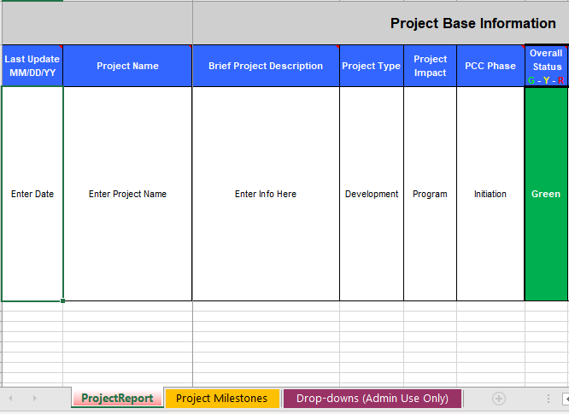
III. Monthly Reports

Slide 12
III. Monthly Reports
The EPMO team reviews the reports along with IV&V reports and other project artifacts to assess project health.
Additionally, the reports are compiled for Statewide Project Portfolio Dashboards at (http://www.doit.state.nm.us/pocd_portfolio.html) and for reporting to the Department of Finance and Administration (DFA), Legislative Finance Committee (LFC), Science, Technology and Telecommunications Committee (STTC) and other stakeholders on a quarterly basis or as requested.
Projects with high dollar values or high risk/visibility, make up the Focus Portfolio’s Top Ten.
Reporting is required to begin upon PCC approval for Initiation phase and must continue monthly through Closeout even if a project is on-hold.
Reporting must be current prior to a certified project coming to PCC for the next phase certification and release of additional funds.

Slide 13
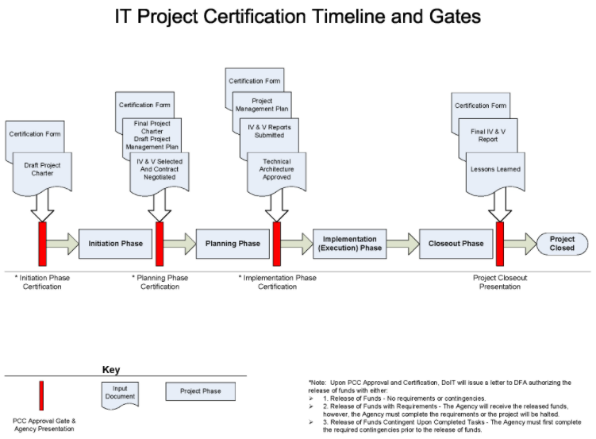
III. Monthly Reports: Project Portfolio Dashboard

Slide 14
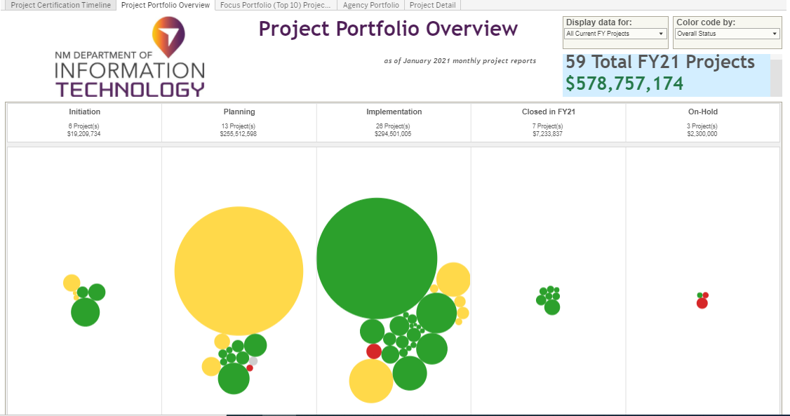
III. Monthly Reports: Project Portfolio Dashboard

Slide 15
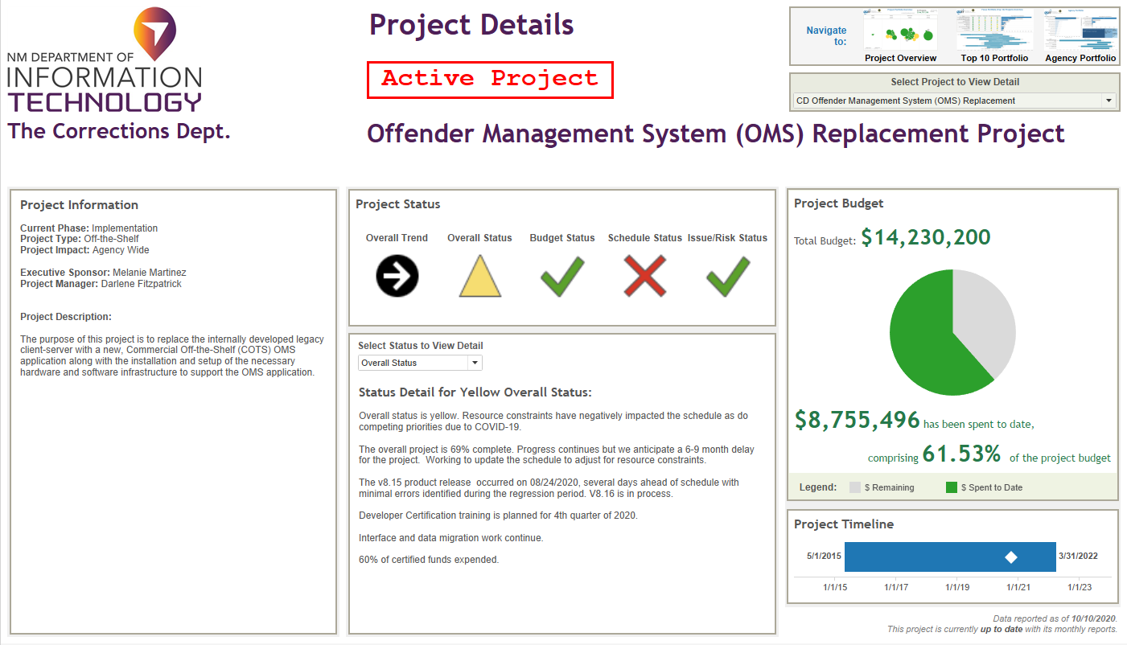
III. Monthly Reports: Project Portfolio Dashboard

Slide 16
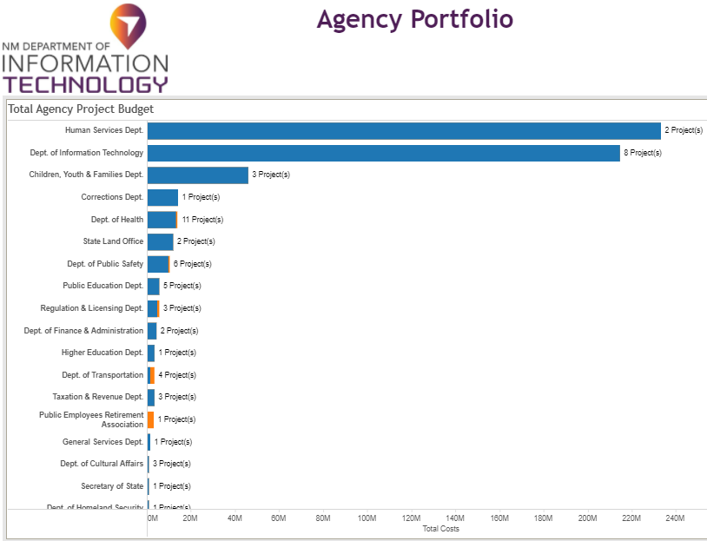
III. Monthly Reports: Project Portfolio Dashboard

Slide 17
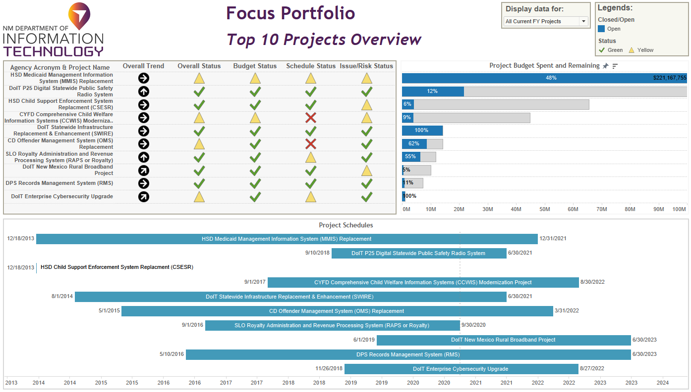
III. Monthly Reports: Project Portfolio Dashboard

Slide 18

Questions Related To:
Criteria for IT project certification
Certifying a project
Use of monthly report data

Slide 19
III. Monthly Report Sections
  Project Base Information
  Project Schedule Status
  Project Budget
  Contact Information
  Project Milestones

Slide 20
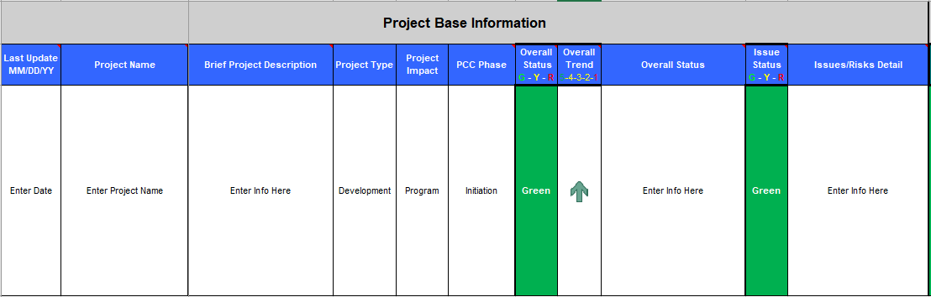
A. Monthly Report - Project Base Information
Consists of general project information, status, issues and risks

Slide 21

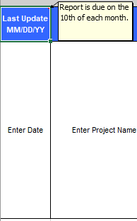
A. Project Base Information: Last Update
Most commonly overlooked field
The title demonstrates the format in which the date should be entered, MM/DD/YY
Ideally, the date should be the 10th of the month in which the report is being sent:
  Example: 1/10/21
Reports contain information for the previous month
  Example: Report submitted 1/10/21 contains information on project activity from 12/01/20 through 12/31/20

Slide 22
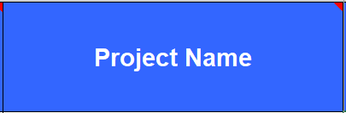
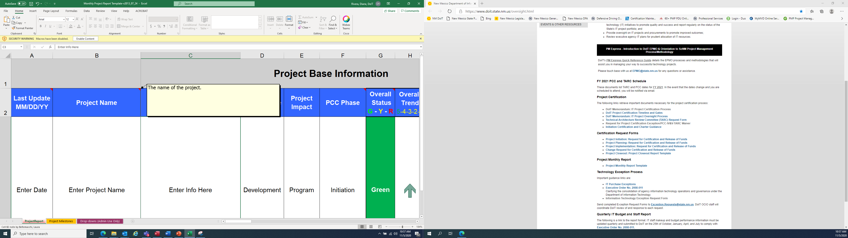
A. Project Base Information: Project Name
The name used when certifying the project for Initiation
Once certified for Initiation, if you want to change the name of the project, the name change should be addressed in documentation used at the project’s next PCC participation
Public data needs to be presented as clearly as possible, if the name is constantly changing, even stakeholders may not be able to identify a project
With any public document, please spell out acronyms before using them, then once the acronym is established, use only the acronym; Run a spell check

Slide 23
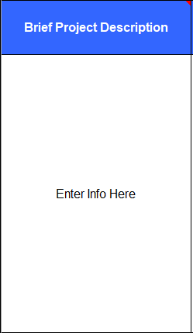
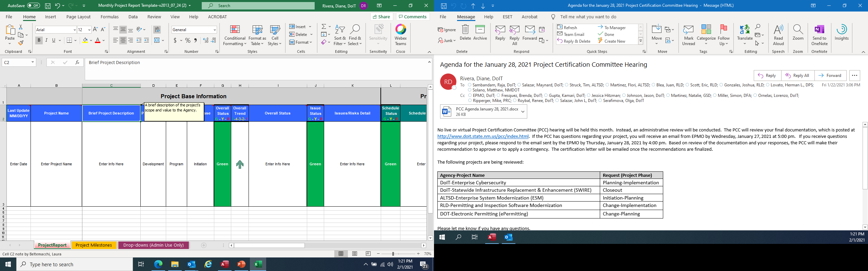
A. Project Base Information: Brief Project Description
Make the statements brief but concise; this description should provide a good understanding of what the project is and should remain the same throughout the project unless the scope changes
Ideally, it should be the same statement used in the Initiation phase and it will be used in the dashboard description
When entering information in a text field in this report, do not use bullets or excessive spacing

Slide 24
A. Project Base Information: Brief Project Description
Example 1:
Original:
Bring an enterprise-based approach for the department’s twelve programmatic bureaus to environmental management using modern digital enhanced tools.
Revised:
To develop a comprehensive data system that will automate the permitting systems, inspections systems, and the development of an automated invoice and payment system that will support 12 bureaus including the Ground Water Quality Bureau, Environmental Health Bureau, Petroleum Storage Tank Bureau and The Hemp Program.

Slide 25
A. Project Base Information: Brief Project Description
Example 2:
Original:
Devise a system of integrated reporting mechanisms from multiple sources to populate an APCD that can be used to report healthcare costs and quality.
Revised:
To create an All Payers Claims Database (APCD) repository of healthcare claims that combines data from multiple payers, including Medicare, Medicaid, private insurers, dental insurers, children’s health insurance, self-insured employer plans and pharmacy plans. The repository will consist of a data storage platform, data analytics and reporting platform and public data presentation.

Slide 26

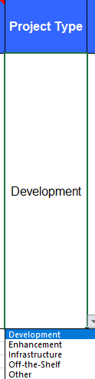
A. Project Base Information: Project Type
Drop down values are:
  Development
  Enhancement
  Infrastructure
  Off-the-Shelf
  Other
If Other is used, make sure to include the project type in the Project Description field

Slide 27

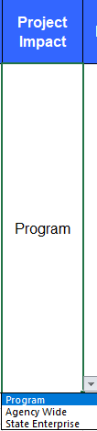
A. Project Base Information: Project Impact
Drop down values describe the level of impact, they are:
  Program
  Agency Wide
  State Enterprise

Slide 28


A. Project Base Information: PCC Phase
Drop down values are:
  Initiation
  Planning
  Implementation
  Close-out
  On-Hold
If you currently certified for a Change Request or an Update, you remain in the last Phase in which you were certified
On-Hold is for projects that have no current activity; If a project remains On-Hold for a lengthy period, you may be asked to provide a PCC update

Slide 29
A. Project Base Information: PCC Phase
If a project had a combined certification, select the 2nd Phase. Example: Initiation/Planning, select Planning, for Planning/Implementation, select Implementation
Do not select Close-out until the project is closed at PCC and the final report is submitted; Intention to close-out can be stated in the Overall Status or the Schedule Status Detail field

Slide 30


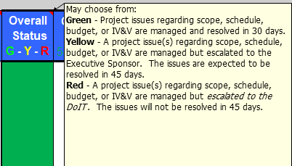
A. Project Base Information: Overall Status G-Y-R
Drop down values are:
  Green
  Yellow
  Red
Quickly shows the overall status of the project; it may be a temporary status; Yellow and Red are not detrimental; Honest communication regarding issue management is key

Slide 31


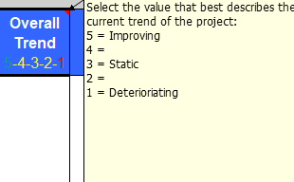
A. Project Base Information: Overall Trend 5-4-3-2-1
Drop down values are:
  5 = Improving
  4
  3 = Static
  2
  1 = Deteriorating
Arrow will display differently with each selection
Quickly and graphically shows the overall trend of the project
5
1

Slide 32
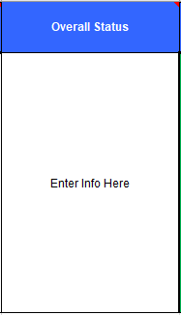
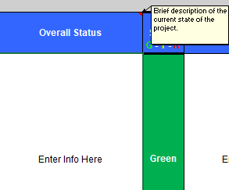
A. Project Base Information: Overall Status
Describe the status of project issues regarding scope, schedule, budget, IV&V or any other topic impacting the project
When entering information in a text field in this report, do not use bullets or excessive spacing

Slide 33
A. Project Base Information: Overall Status
Example 1:
Project is currently in planning phase. PCC approved $500,000.00 for project planning, management and administrative support. Risks have been identified and mitigation plan is in place. Site surveys that began May 4th are complete and total number completed to date are 83. We are waiting for design documents from the vendor. Advisory Committee members were selected. Will certify for implementation phase and request additional funding in October.
Example 2:
Majority of planning phase activities are completed including functional requirements report, design documents and IV&V contract. We are now selecting a software vendor and preparing for Implementation Phase request and Technical Architecture Review Committee (TARC).

Slide 34

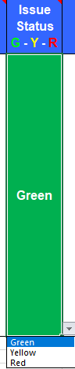
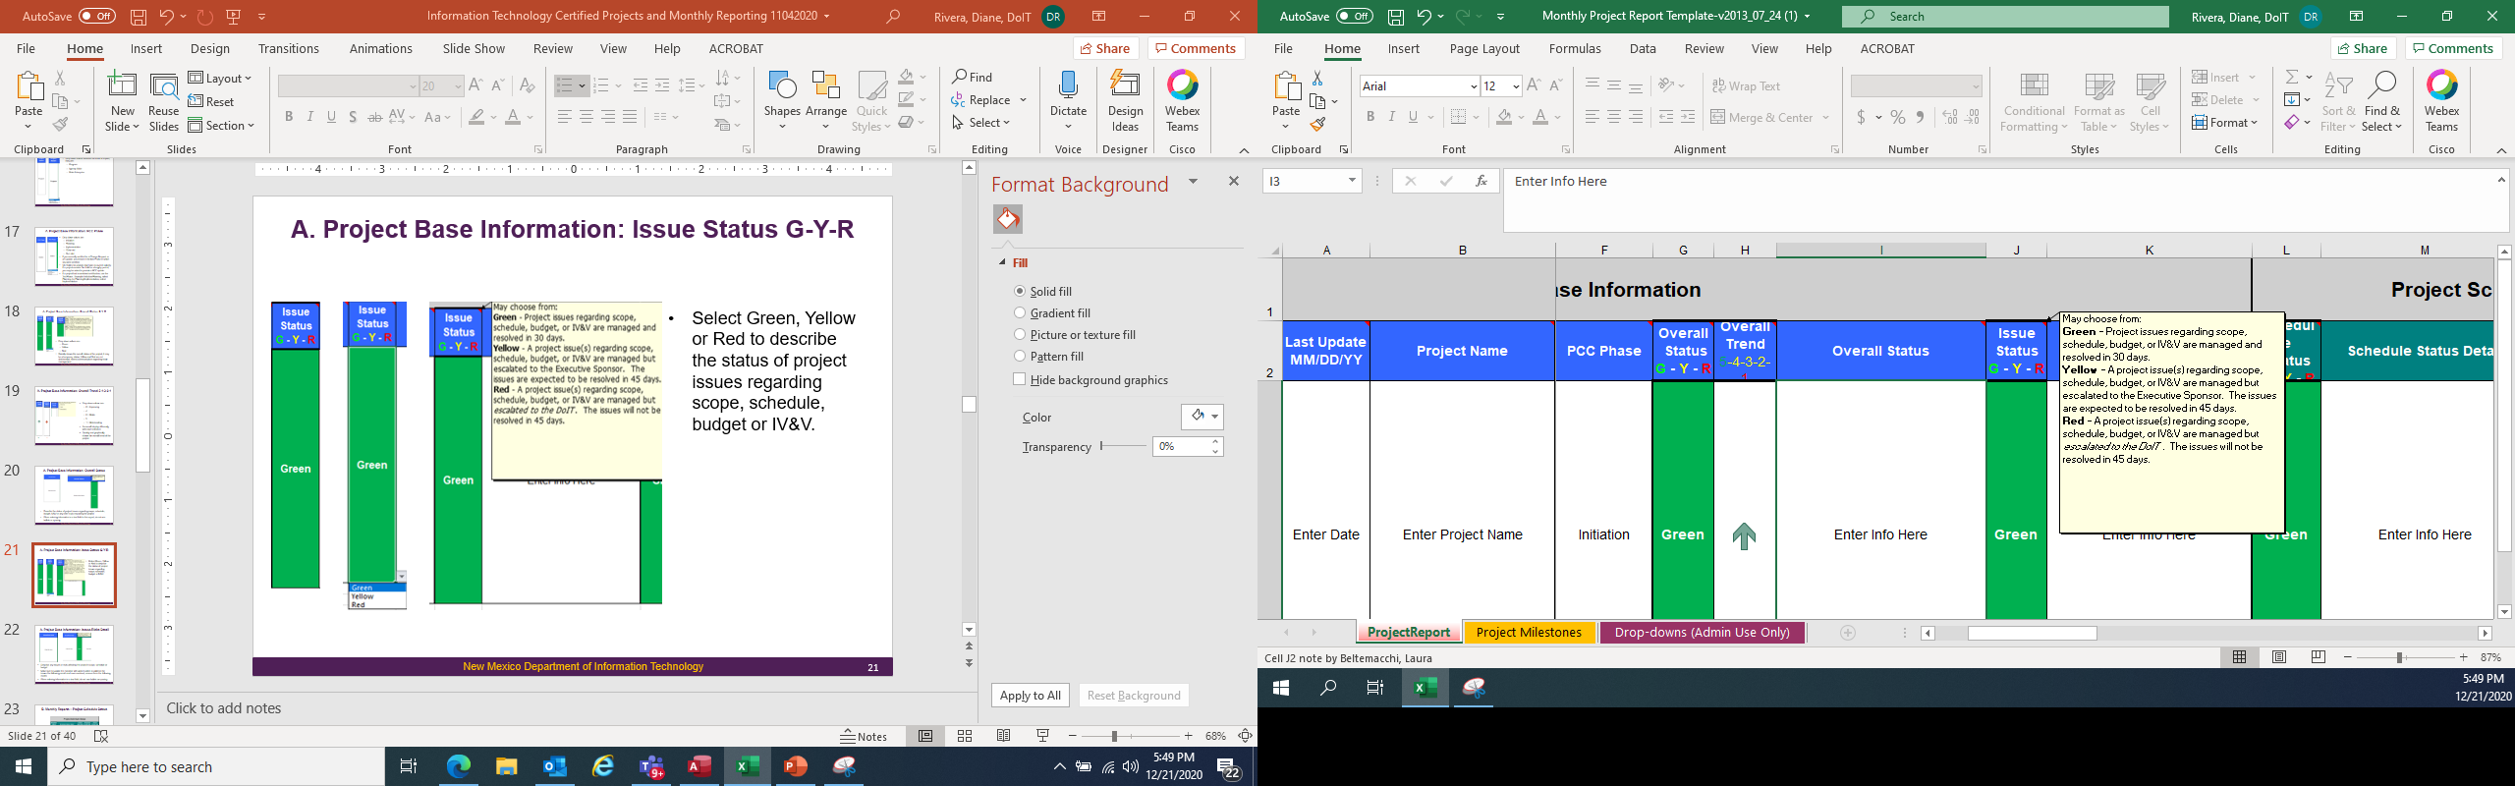
A. Project Base Information: Issue Status G-Y-R
Select Green, Yellow or Red to describe the status of project issues regarding scope, schedule, budget or IV&V

Slide 35
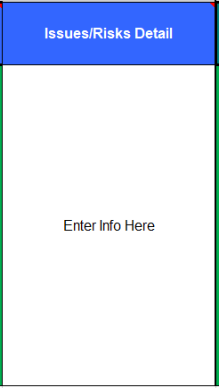
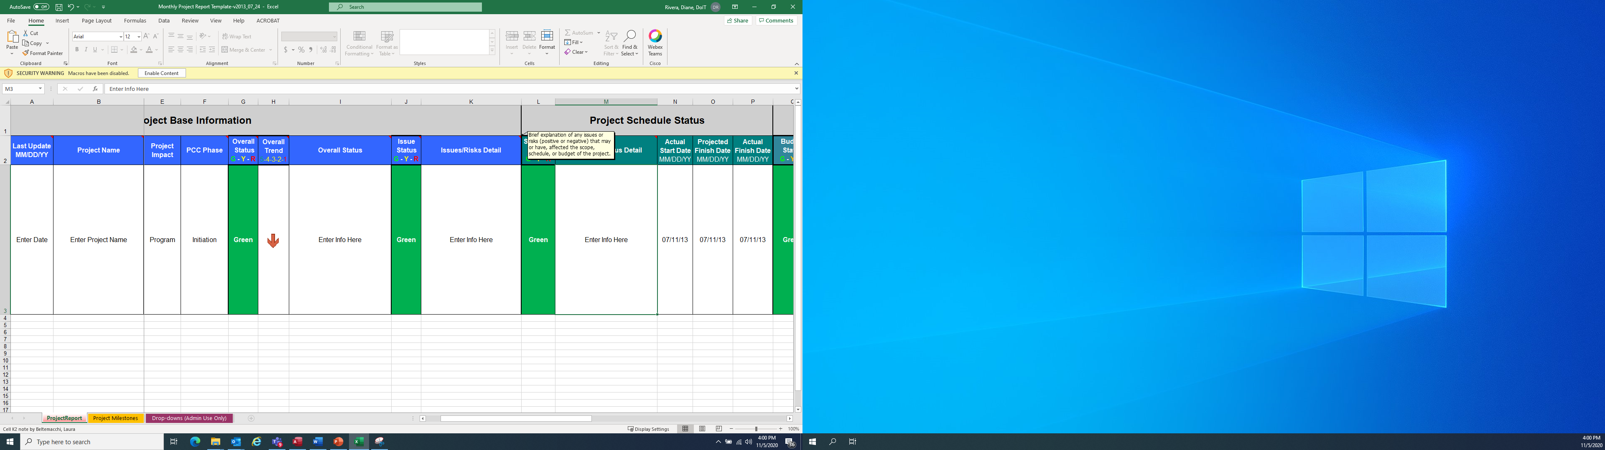
A. Project Base Information: Issues/Risks Detail
Describe any issues or risks affecting the project’s scope, schedule or budget
Make sure to update the narrative with actions taken to address the issues and the following month or once resolved, remove them unless they are still impacting the project
When entering information in a text field, do not use bullets or excessive spacing

Slide 36
A. Project Base Information: Issues/Risks Detail
Example 1:
1) There are schedule delays due to pandemic with Steering Committee and vendor inability to meet as necessary. 2) A separate project related to Chart of Accounts was not completed in a timely manner and caused a delay to this project’s testing and implementation.
Example 2:
The quarterly risk review and reassessment was completed by the team in December. The inventory is current and mitigation plans have been updated for all risk items scored 6 or higher in the risk management plan. Next quarterly risk review and reassessment is scheduled in February 2021.

Slide 37
Questions Related To:
  Project Base Information

Slide 38
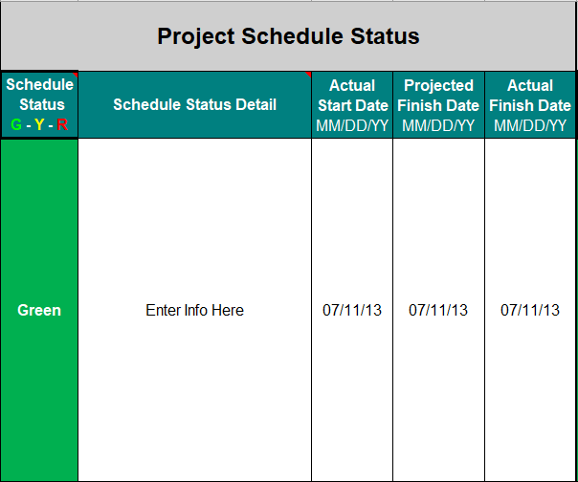
B. Monthly Report – Project Schedule Status

Slide 39
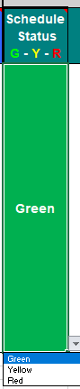
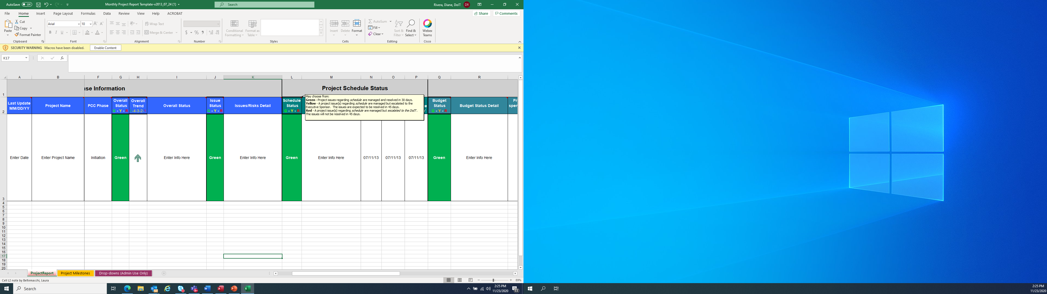
B. Project Schedule Status: Schedule Status, G-Y-R
Select Green, Yellow or Red to describe the schedule status

Slide 40
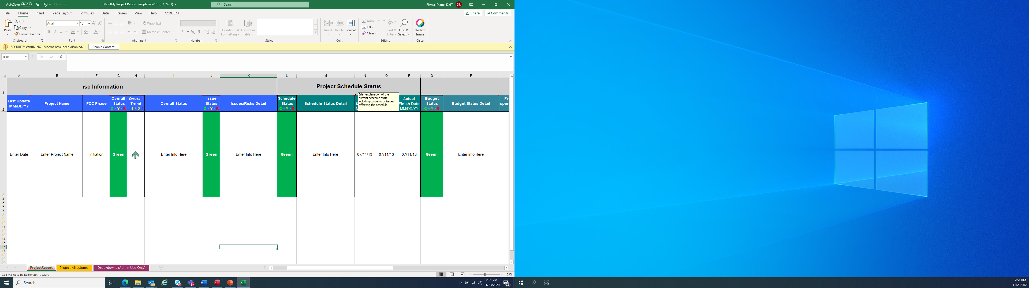
B. Project Schedule Status: Schedule Status Detail
Briefly describe the current schedule status including major milestones completed, delays, concerns or issues; Include tentative future certification dates
When entering information in a text field, do not use bullets or excessive spacing

Slide 41
B. Project Schedule Status: Schedule Status Detail
Example 1:
Upcoming Events: 1) Completion of requirements gathering to be completed by December 8, 2020. 2) Begin data conversion planning by February 1, 2021. 3) Implementation certification anticipated in April.
Example 2:
Executive Steering Committee was informed that schedule will be tighter due to intended “slack time” being used to address delays caused by the pandemic. IV&V vendor has spoken to us concerning this issue and agree it is being addressed. Status or removal of this issue will be reflected in the next report.

Slide 42
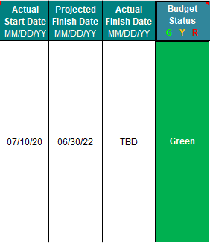
B. Project Schedule Status: Actual Start Date, Projected Finish Date and Actual Finish Date
Date format is mm/dd/yy
Actual Start Date – Date of project Initiation
Projected Finish Date – Estimated end date from last certification documents
Actual Finish Date – Until project is closed, enter TBD (to be determined), unless you have a firm end date; When project is closed out at PCC enter date of PCC meeting
If these dates differ from PCC estimates, the date change must be presented at the following PCC certification

Slide 43
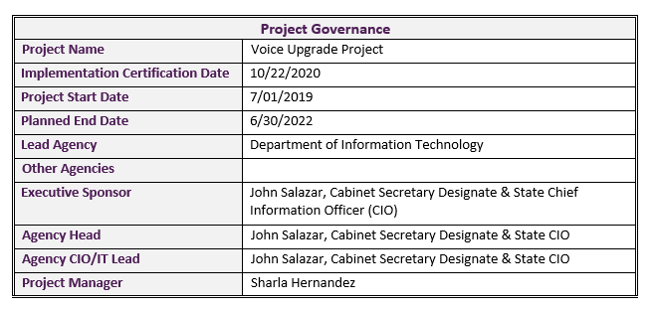

B. Project Schedule Status:

Slide 44
Questions Related To:
  Project Schedule

Slide 45
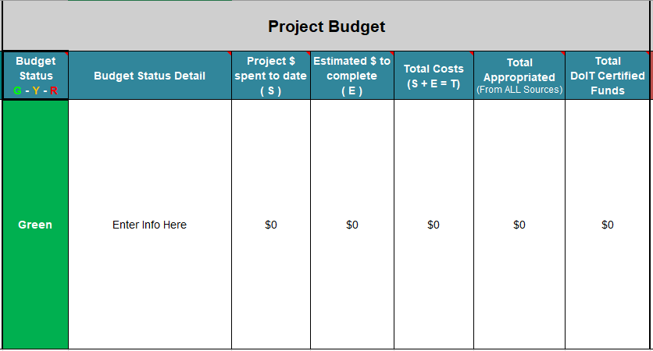
C. Monthly Report - Project Budget
Consists of budget status narrative and specific budget amounts

Slide 46
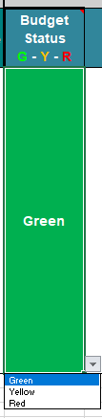
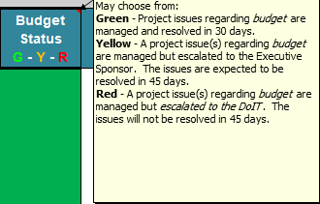
C. Project Budget: Budget Status, G-Y-R
Select Green, Yellow or Red to describe the budget status.

Slide 47

C. Project Budget: Budget Status Detail
Briefly describe the budget status; Include PCC phases completed with related certified funds, explanation of federal matches, changes impacting any of the five monetary amount fields that follow
When entering information in a text field, do not use bullets or excessive spacing

Slide 48
C. Project Budget: Budget Status Detail
Example 1:
The Center for Medicare and Medicaid Services (CMS) authorized a $6,000,000 budget to replace the current system. This project is supported by a mixed rate of 90% Federal Funding Participation (FFP) and 10% State General Fund. 2/25/20: Initiation Certification – $120,000; 9/26/20: Planning Certification - $900,000.
Example 2:
$1,571,048.00 - Appropriated
$129,000.00 - PCC Certified (Initiation Phase) - February 28, 2018
$230,948.00 - PCC Certified (Planning Phase) - August 22, 2018
$1,090,100.00 - PCC Certified (Implementation Phase) - June 27, 2019
$1,571,048.00 - Total Certified
$808,391.18 - Total Expensed as of April 8, 2020

Slide 49
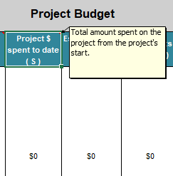
C. Project Budget: Project Spent to Date (S)
Enter the total amount that has been spent on the project, since Initiation. This is a monetary field, enter numbers only
Amount can be encumbrances or actual expenditures, specify which are being tracked in the budget status detail field and be consistent
If you have explanatory text, do not enter it here – enter it in the Budget Status Detail field

Slide 50
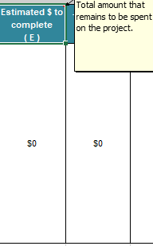
C. Project Budget: Estimate $ to Complete (E)
Enter the total dollar amount to be spent on the project. Usually, this amount will not exceed the current appropriation amount, but there are some exceptions. This is a monetary field, enter numbers only
Again, if you have explanatory text, do not enter it here – enter it in the Budget Status Detail field

Slide 51
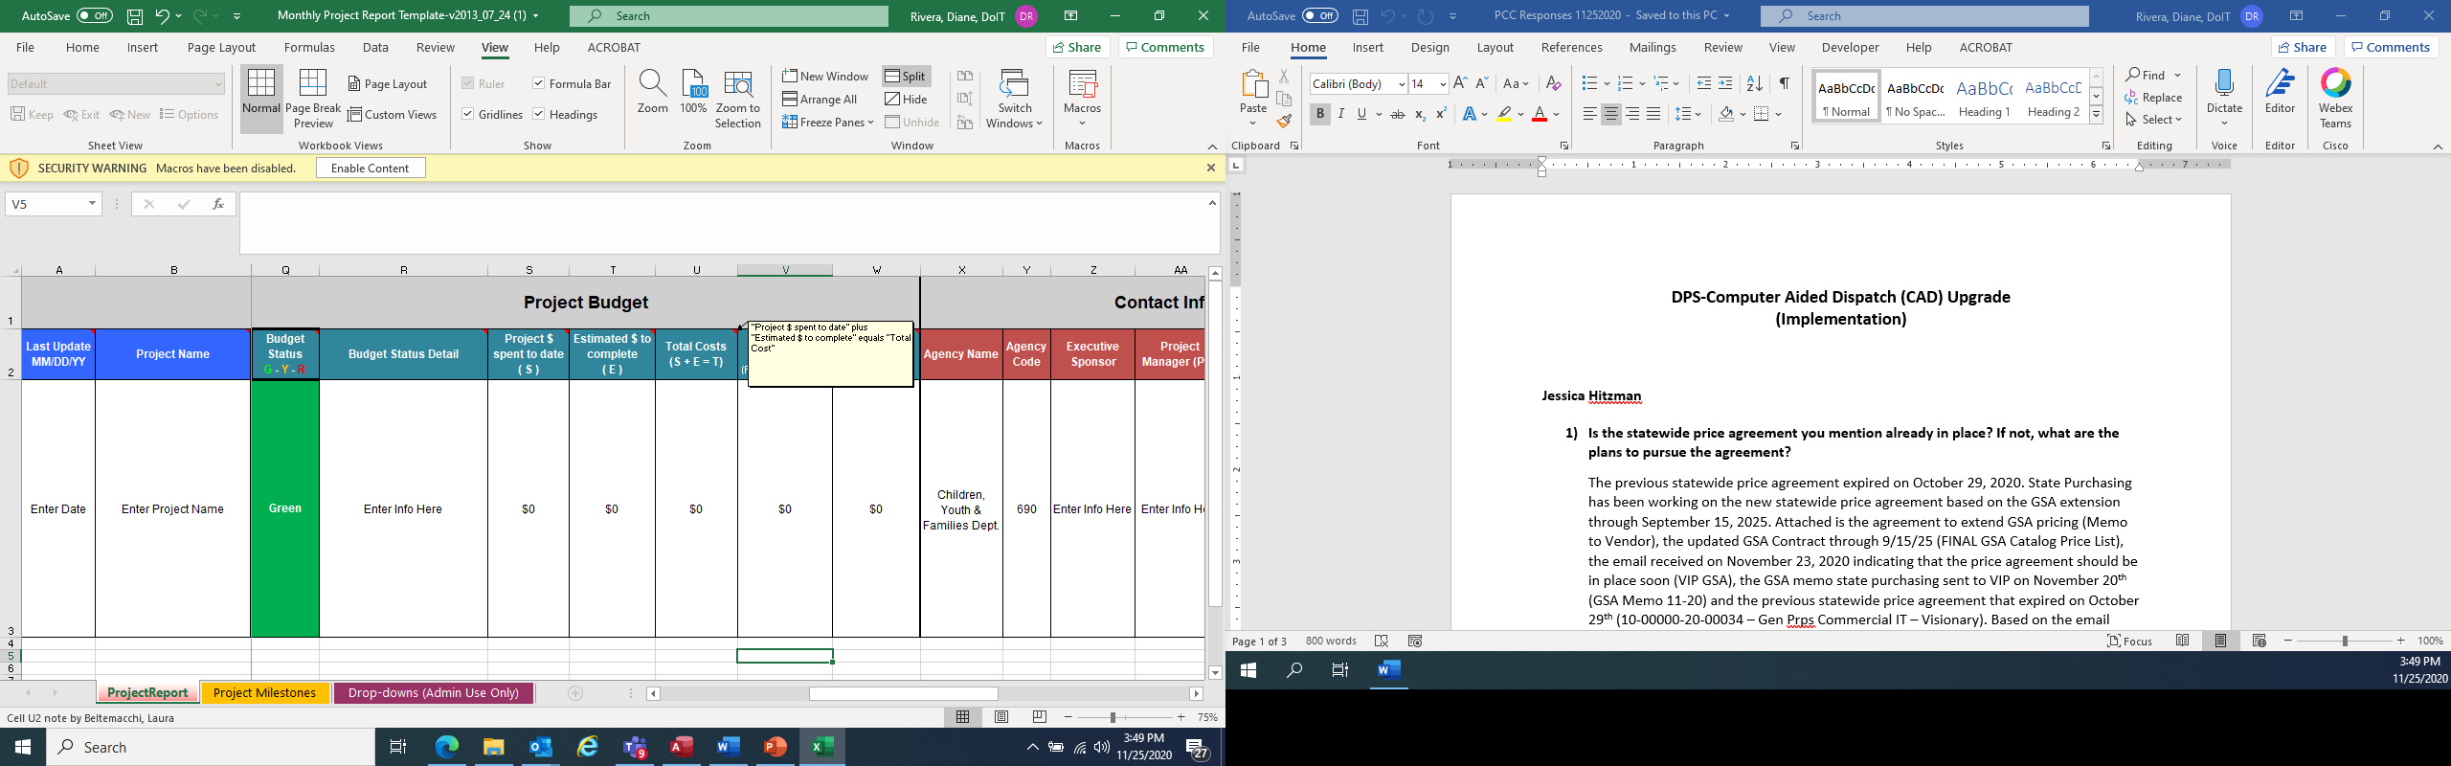
C. Project Budget: Total Costs (S+E=T)
This is the sum of Project $ spent to date and Estimated $ to complete fields. This is a monetary field, enter numbers only
Again, if you have explanatory text, do not enter it here – enter it in the Budget Status Detail field

Slide 52
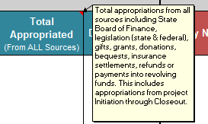
C. Project Budget: Total Appropriated
Enter the sum of all appropriations allocated to the project. This amount should match the appropriation listed in your most current PCC documentation. This is a monetary field, enter numbers only
If you have explanatory text, do not enter it here – enter it in the Budget Status Detail field

Slide 53
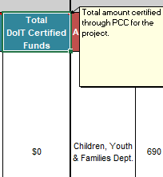
C. Project Budget: Total DoIT Certified Funds
Enter the sum of all PCC certified funds for the project. This amount should match the total amount of certified dollars listed in your most current PCC documentation. This is a monetary field, enter numbers only
If you have explanatory text, do not enter it here – enter it in the Budget Status Detail field

Slide 54
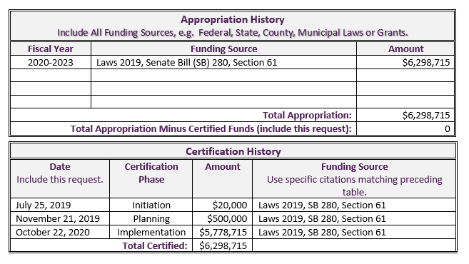
C. Project Budget:

Slide 55
Questions Related To:
  c) Project Budget

Slide 56
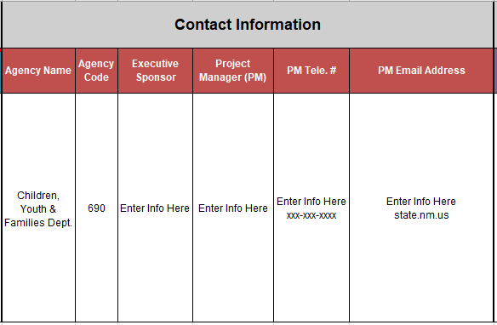
D. Monthly Report - Contact Information

Slide 57
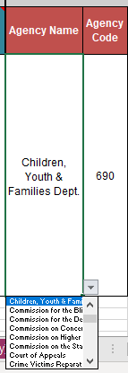
D. Contact Information: Agency Name and Agency Code
Select your Agency Name from the drop-down field
Based on your Agency Name selection, the Agency Code field will auto-populate

Slide 58
D. Contact Information: Sponsor, Project Manager
Update information when staff changes occur
Executive Sponsor: first and last name
Project Manager: first and last name
Project Manager Telephone Number: (xxx) xxx-xxxx
Project Manager Email Address

Slide 59
Questions Related To:
  d) Contact Information

Slide 60
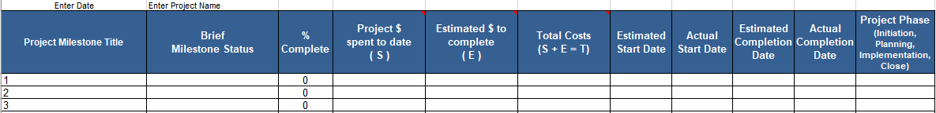
E. Project Milestones
2nd tab of the Monthly Project Report Template
A milestone describes what the project is supposed to achieve at a pre-set date
Enter Date and Enter Project Name fields are auto-populated by cells A3 and B3 on the Project Report tab

Slide 61
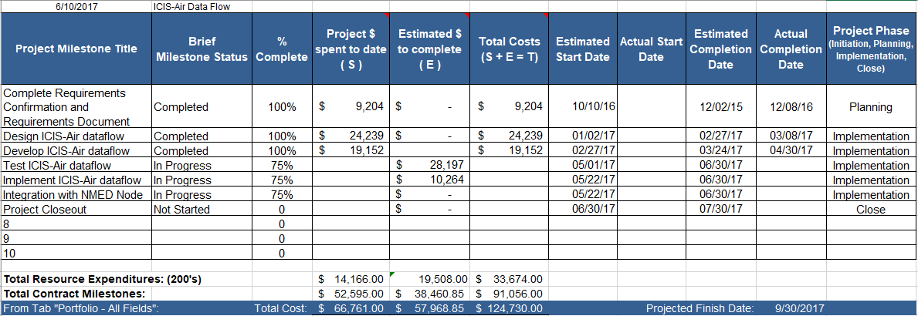
E. Project Milestones
Example 1:

Slide 62
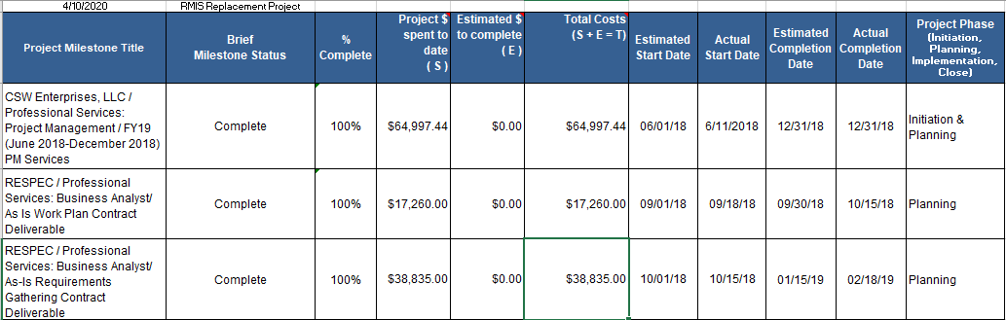
E. Project Milestones
Example 2:

Slide 63
E. Project Milestones
Provide a descriptive Project Milestone Title
Enter a Brief Milestone Status that includes any pertinent details
Enter the % Complete for the Milestone
Milestones should be traceable back to your overall project schedule/timeline; multiple tasks in your plan may be rolled-up into substantive milestones

Slide 64
E. Project Milestones
All fields that were entered in the ProjectReport tab, but here the entries relate to the specific Milestone
  Project $ spent to date
  Estimated $ to complete
  Total Costs
  Estimated Start Date
  Actual Start Date
  Estimated Completion Date
  Actual Completion Date
  Project Phase

Slide 65
E. Project Milestones
Total Milestones are calculated from the entries
Entries in the From Tab “Portfolio – All Fields” updated by fields from ProjectReport:
  Project $ Spent to Date (S)
  Estimated $ to Complete (E) and
  Total Costs (S+E=T)
Difference is calculated from the total cost for milestones minus the total cost of the category
Projected Finish Date auto-populates from ProjectReport O3 field

Slide 66
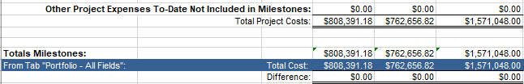
E. Project Milestones
Example 1:
Example 2:

Slide 67
Questions Related To:
  e) Project Milestones

Slide 68
Conclusion
Thank you for attending
Always feel free to email your monthly report questions to epmo@state.nm.us

