Slide 1

Information Technology Agreement
Review Process
Department of Information Technology (DoIT)
Compliance and Project Management Program
Enterprise Project Management Office (EPMO)
April 2023

Slide 2
Large Contract Review - Criteria
Large Contract Template
  Used for contracts over $60,000 or
  When term is longer than one year (up to 4 years) or
  if preferred by Procuring Agency.
  Always reviewed by DoIT EPMO.
Small Contract Template
  Used for contracts under $60,000,
  Term is one year or less,
  Reviewed and Signed by DoIT if the contract is related
Purchase Orders
  For IT procurements other than IT professional services contracts, Cabinet Level CIOs may approve IT purchases/leases for renewal of software licenses, hardware maintenance, and support for services such as printers, copiers, and facility maintenance at or below one hundred thousand dollars ($100,000) using a purchase order and that are:
  not restricted by IT Consolidation directives listed in Executive Order (EO) 2008-11;
  included in and are consistent with the Agency IT plan, state architectural standards and the State IT Strategic Plan;
  not part of an IT project or initiative requiring DoIT approval; and
  not deemed by DoIT to possess substantial risk.

Slide 3
Large Contract Review - Criteria
The Professional Services Agreement Template used for large purchases $60,000 and can be found on the DoIT Website. The amount can exceed $60,000 if the amount before tax is less than $60,000.
The template on our website should always be used as the basis for a contract. EPMO does not recommend editing a previously reviewed contract. Start with a blank template.
The large template can also be used for amounts less than $60,000 (excluding GRT), without exception. This is often done if the intent is to later amend the contract or if the term is over 1 year. A small contract template however cannot be used for contracts over $60,000.
The Procuring Agency should send contracts to epmo@doit.nm.gov for review prior to being routed for any signatures.
  The contract should be in a final state and should not be watermarked as drafts. If they are and that’s the only thing that indicates that it is not finalized, the DoIT EPMO Project Manager (PM) will remove the watermark prior to beginning their review and before turning on track changes.
  If there are comments or tracked changes in the contract, the contract will be returned to the Procuring Agency and asked return a final contract without comments or tracked changes.
The EPMO will check to ensure that it is the most current version of the contract template is being used by conducting a “Compare” of the contract against the current template.

Slide 4
Contract Review: Running a Compare
For all large and small contracts received, DoIT EPMO will compare the most recent version of the IT Contract Template against the contract being sent for review by the Procuring Agency.
A comparison is used to identify any changes, deletions and additions that are made to the terms and conditions and to verify the appropriate choices are made based on the Scope of Work.
If changes are made to the terms and conditions DoIT EPMO will add a comment to point out the deviations but will not edit the text.
If the Procuring Agency requires an immediate review or has a specific area(s) of concern, a return date and reason should be requested by the Procuring Agency, to promote a timely review.
If changes to the terms and conditions are identified by EPMO, the contract/amendment will be forwarded to DoIT’s Office of General Counsel and a deviation memo will be requested from the Procuring Agency if one did not accompany the contract sent for review.

Slide 5
Contract Review: Deviation Memo
As of February 2021, if substantive changes to the Terms and Conditions are made to the Contract Template a deviation memo addressed from the Procuring Agency Office of General Counsel (OGC) or equivalent to DoIT’s (OGC) will be required.
If Agencies have additional articles that they consistently use, such as federal requirements, they should coordinate with their DoIT EPMO Project Manager to submit one deviation memo and establish/use an agency specific contract template that includes such articles.
The deviation memo should be completed by the Procuring Agency’s general counsel and should accompany all contracts that have deviations to the contract template terms and conditions.
The list of deviations and the justification for each change included in the memo will explicitly verify the changes have been reviewed and accepted by the Procuring Agency’s general counsel and executive authority authorized to approve expenditures.

Slide 6
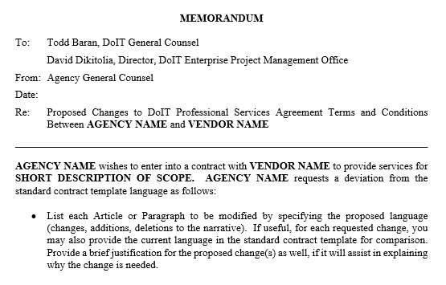
Contract Review: Changes to Ts & Cs

Slide 7
Large Contract Review - Sections
Header and Parties
  Agreement Number, Procuring Agency Name and Contractor Name
Whereas
  Procurement Code
  State Use Act
  Procurement Method
Terms and Conditions
  Definitions & Articles
Signature Pages
Scope of Work/Exhibit A
Appendices or Attachments

Slide 8
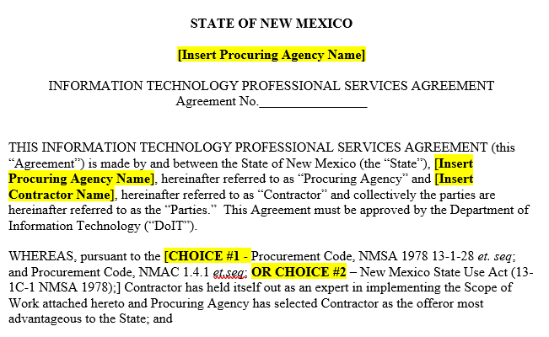
Header – Template and Guidance
  The agreement number will be used as the basis for naming the agreement and tracking the EPMO’s review and correspondence related to this agreement.
  Often, the agreement number is not available at time of the review. When not available, a number composed of the fiscal year and the agency code will be used a temporary agreement number. A short description of the SOW or personnel named in Article 12 may also be temporarily included. (Example: 23-665 = DOH contract sent in FY23).
  A final agreement number is required prior to signature.

Slide 9
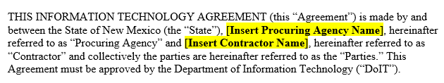
Parties – Template and Guidance
  After this point, the Procuring Agency Name and Contractor Name are not used. ALL references within the contract and Scope of Work are to “Procuring Agency” or “Contractor” only:
    “Procuring Agency”
      NOT procuring agency, agency, department, Agency, the name of the agency or the agency acronym
    “Contractor”
      - NOT contractor, the name of the contractor or acronyms representing the contractor or specific subcontractors
    Collectively referred to as “the Parties” – e.g “the Parties agree”

Slide 10
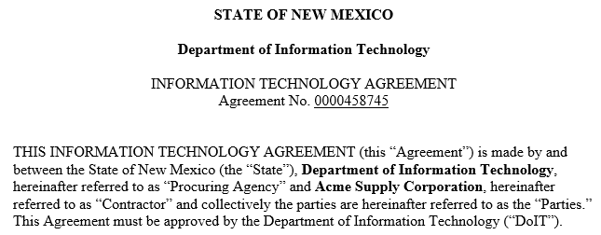
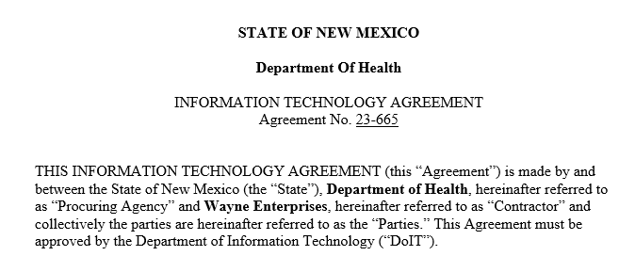
Header and Parties - Examples
Example 1 – Department of Information Technology and ACME Supply Corporation
Example 2 – Department of Health and Soylent Corporation

Slide 11
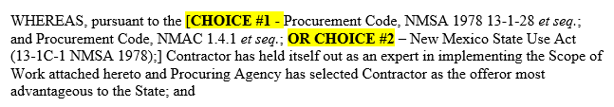
Whereas - Procurement Code and State Use Act – Template and Guidance
Choice #1 – Procurement Code - will be used most often and is applicable to all procurement methods (i.e. Request For Proposals (RFP), Sole Source, Emergency Procurements, and State Price Agreements (SWPAs) except the State Use Act.
Choice #2 – NM State Use Act is selected ONLY when utilizing services offered through Horizons New Mexico Council for Purchasing from Persons With Disabilities.

Slide 12

Whereas - Procurement Code and State Use Act – Example
Choice #1 Procurement Code, NMAC 1.4.1 or
Choice #2 NM State Use Act, the NM Council for Purchasing from Persons with Disabilities

Slide 13
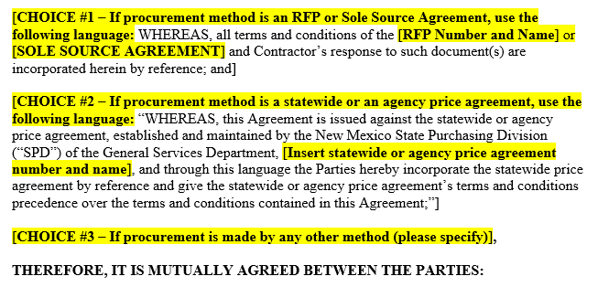
Whereas - Procurement Method – Template

Slide 14
Whereas - Procurement Method – Guidance
Regardless of Procurement Method, the specific NAME and NUMBER must be provided.
If the contract is based on a Statewide or Agency Price Agreement (SWPA) the SWPA is verified by EPMO by checking the General Services Department (GSD) website (see URL below) and searching by the price agreement number that is entered on the contract.
https://www.generalservices.state.nm.us/state-purchasing/statewide-price-agreements/
The SWPA is also used
to validate the Term in the SWPA to make sure it is still active.
to validate the Contractor’s approved IT Professional Service Category in Article 12.
to validate the proposed Key Personnel and $$/hour rate in Article 12.
and to determine the Total Compensation for each Deliverable.

Slide 15
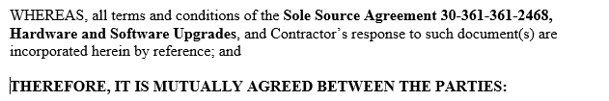

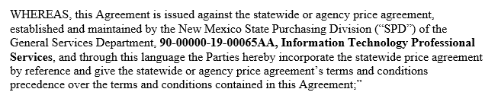
Whereas - Procurement Method – Examples
Choice #1 – Sole Source - Example
Choice #1 – RFP - Example
Choice #2 – Statewide Price Agreement (SWPA) - Example

Slide 16

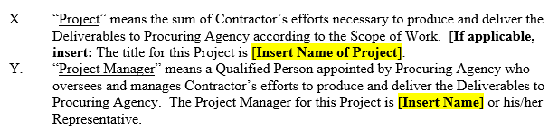
Article 1 - Contract Manager, Project Name, Project Manager Name – Template

Slide 17
Article 1 - Contract Manager, Project Name, Project Manager Name – Guidance
To promote separation of duties, DoIT highly recommends that the Contract Manager and the Project Manager are unique and identified in each contract.
A unique Procuring Agency Executive Level Representative (ELR) is also assumed as each role has unique responsibilities specifically regarding acceptance and change requests.
Contract Manager - A Qualified Person designated by Procuring Agency who is responsible for all aspects of the administration of this Agreement.
Project Manager - A Qualified Person appointed by Procuring Agency who oversees and manages Contractor’s efforts to produce and deliver the Deliverables to Procuring Agency.
Executive Level Representative (ELR) - The individual designated and empowered with the authority to represent and make decisions on behalf of Procuring Agency or the Representative of the Executive Level Representative.

Slide 18
Article 1 - Project Manager – Guidance
Project Manager –
Article 2 – A. Protection of Data - In the event a Data Damage incident occurs Contractor will notify the Project Manager concerning the Data Damage incident, including sufficient information for the Project Manager to determine, in conjunction with Contractor, measures, if any, Contractor must implement to mitigate the Data Damage.
Article 4 - B. Acceptance - In order to Accept a Deliverable, the ELR, in conjunction with the Project Manager, will perform a Quality Assurance Review of the Deliverable.
Article 12 - B. Personnel Changes - Contractor’s personnel replacements must be pre-approved in writing by Procuring Agency’s Project Manager.
Article 14- Change Requests - The Project Manager will draft written Change Requests for the ELR’s review and approval.
Article 15 - Independent Verification and Validation - Contractor’s cooperation regarding IV&V includes supplying the IV&V vendor with any/all other information and/or material(s) as directed by the Project Manager.

Slide 19
Agency Executive Level Representative (ELR) – Guidance
Executive Level Representative (ELR) –
Article 4 – A. Acceptance - According to Section 13-1-158 NMSA 1978, the ELR will determine whether the Deliverable(s) meet(s) the specifications stated in the SOW. Procuring Agency will not pay for any Deliverable until the ELR Accepts the Deliverable in writing.
Article 4 - B. Acceptance - In the event the ELR Accepts a Deliverable the ELR will send Contractor the ELR’s written Acceptance within the “Acceptance/Rejection Period” from the date the ELR receives each of Contractor’s Payment Invoice(s).
Article 4 - C. Rejection - The ELR is referenced eleven times (11x) in this paragraph with very specific responsibilities if a deliverable(s) is rejected.
Article 11 - B. - Software (Warranty Period) - Contractor further warrants that Software will meet the Applicable Specifications following Acceptance by the ELR and implementation by Procuring Agency.
Article 14 - Change Management - The ELR will provide a written decision concerning each Change Request to Contractor within ten (10) Business Days of the ELR’s receipt of each Change Request. All decisions made by the ELR concerning a Change Request will be deemed final. Each Change Request, once approved by the ELR, will be integrated into the SOW through an Amendment executed by the Parties if required by Article 25, Section 2.

Slide 20
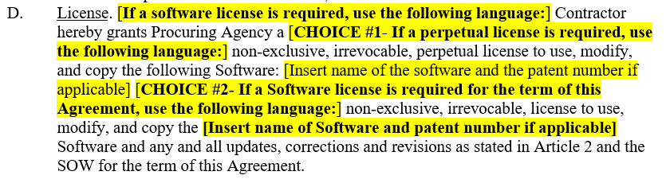
Article 2.F. License – Template

Slide 21
Article 2.F. License – Guidance and Examples
Choice #1 – Perpetual License
Used when the State will “own” the license of the software being produced or provided by the Contractor. This implies no additional “license costs” are required to use the software indefinitely.
Choice #2 – Required for Term of Agreement
Used when the license of the software being produced or provided by the Contractor is directly tied to the Term of the Agreement. The “license cost” is assumed to be included in Exhibit A - Scope of Work and any related Contractor responsibilities described. This section should align with E. Source Code selection
Choice #3 – Not Applicable
Used for services or any other instances when the Contractor is not providing software.

Slide 22
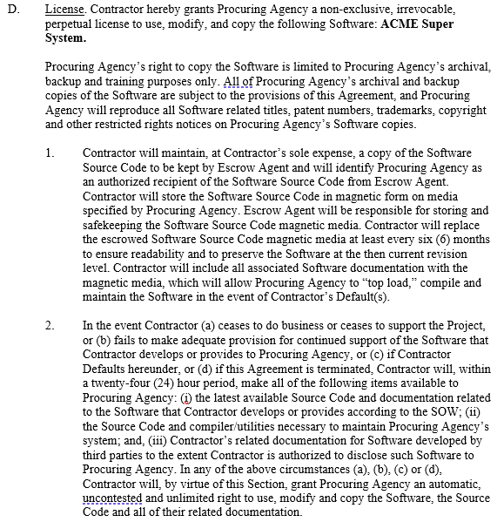
Article 2.F. License – Examples
Choice #1 – Perpetual License
Used when the Procuring Agency/State will “own” the license of the software being produced or provided by the Contractor.
This implies use the software indefiniteno additional “license costs” are required to ly.

Slide 23
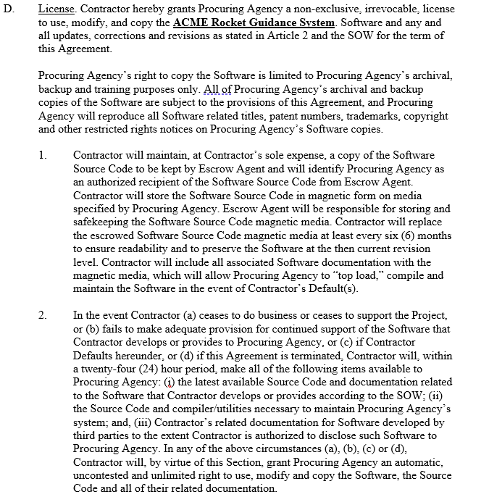
Article 2.F. License – Examples
Choice #2 – Required for Term of Agreement
Used when the license of the software being produced or provided by the Contractor is directly tied to the Term of the Agreement.
A description of the Procuring Agency rights, and the Contractor’s responsibilities related to the License should be included as a deliverable/tasks in Exhibit A - Scope of Work.

Slide 24
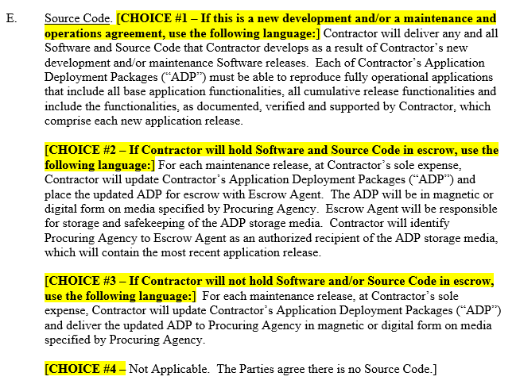
Article 2.E. Source Code - Template

Slide 25
Article 2.E. Source Code - Guidance
CHOICE #1 – Immediate Delivery of Software and Source Code
  Examples include new or custom development and/or a maintenance and operations agreements for custom developed solutions
CHOICE #2 – Software and Source Code Held in Escrow
  Protects the Procuring Agency’s investment by guaranteeing the long-term availability of third-party software and data while preserving the developer's Intellectual Property Rights (IPR).
  Should align with Article 2.F. License.
CHOICE #3 – If Contractor will not hold Software and/or Source Code in escrow, use the following language.

Slide 26
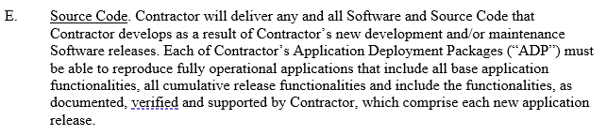
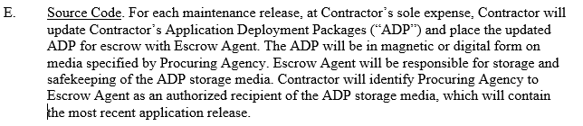
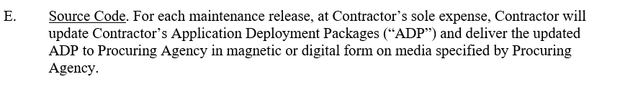
Article 2.E. Source Code - Examples
CHOICE #1 – Immediate Delivery of Software and Source Code
CHOICE #2 – Software and Source Code Held in Escrow
CHOICE #3 – Software and Source Code will not be held in Escrow

Slide 27
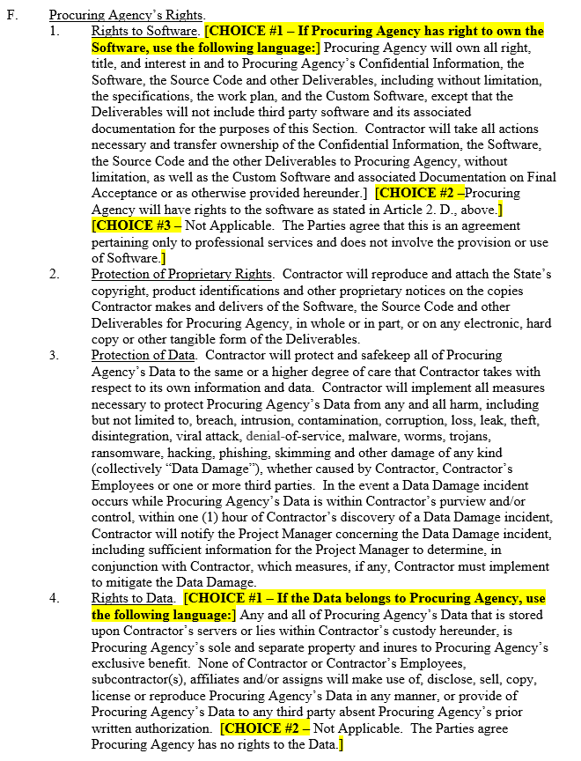
Article 2.F.1 Procuring Agency Rights to Software- Template

Slide 28
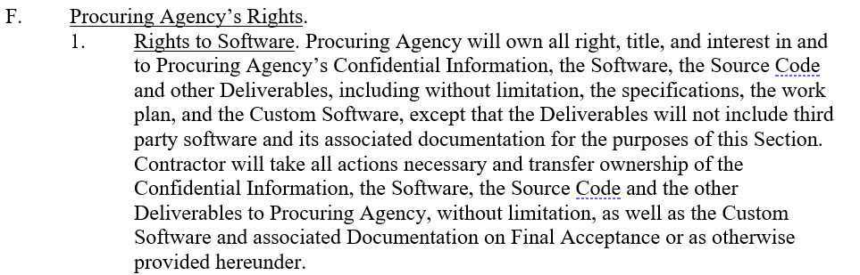

Article 2.F.1 Procuring Agency Rights to Software - Examples
Choice 1 – Procuring Agency has right to own Software - Use when software is being developed and/or provided by the Contractor. This should align with the choices in Article 2.D License and F. Source Code.
Choice 2 – Parties agree the Agreement is for IT Professional Services ONLY
Use when the agreement is for Professional Services pertains to professional services ONLY and does not involve the provision or use of Software.

Slide 29
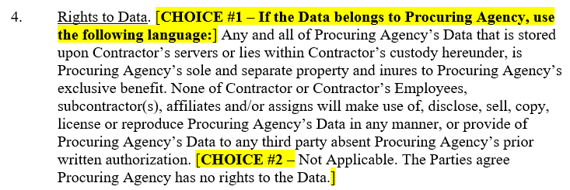
Article 2.F.4 Rights to Data – Template and Guidance
Choice #1 Data Belongs to Procuring Agency
Use when any data is collected, shared or stored by the Contractor. This explicitly protects the Data being used by the Contractor for any other purposes other than what is prescribed in this Agreement.
Choice #2 Not Applicable
Used when the Agreement is for Professional Services only and/or in the rare instance when Procuring Agency does not have rights to the data collected or stored by the Contractor.

Slide 30
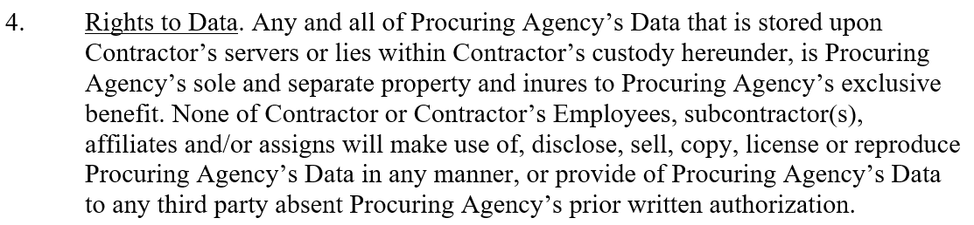
Article 2.F.4 Rights to Data – Example
Choice #1 - Data Belongs to Procuring Agency
Choice #2 - Not Applicable

Slide 31
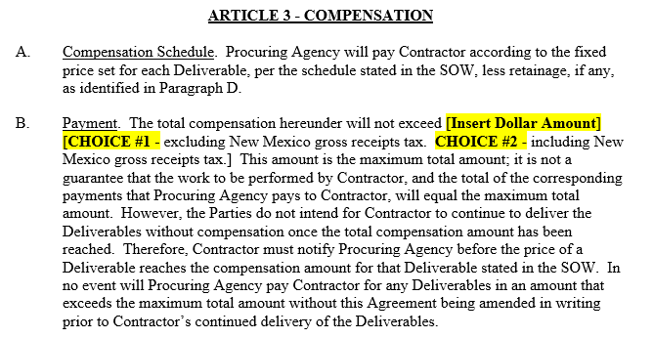
Article 3 Compensation – Template and Guidance
Either Choice #1 or Choice #2 requires alignment with Article 3 C. Taxes and the Total Compensation of each Deliverable.
The Total Compensation Amount should align and not exceed the sum of the Total Compensation Amounts of all Deliverables in the SOW.

Slide 32
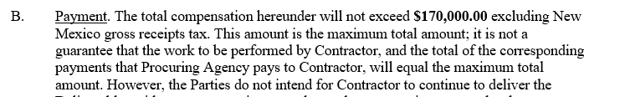
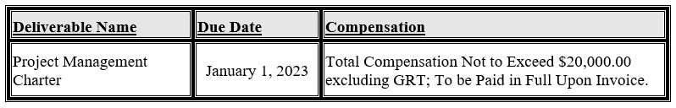
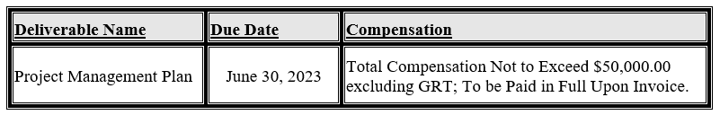
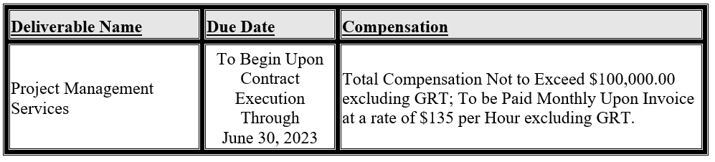
Article 3 Compensation – Excluding GRT Example
  Choice #1 – Total Compensation excluding New Mexico gross receipts tax

Slide 33
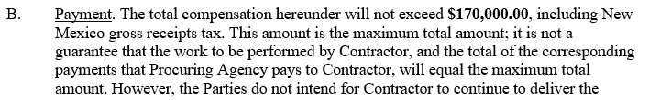
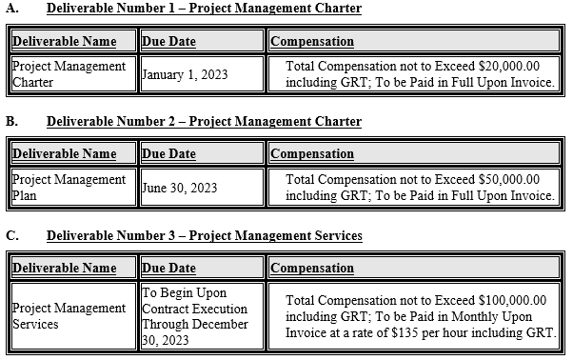
Article 3 Compensation – Including GRT Example
  Choice #2 – Total Compensation including New Mexico gross receipts tax

Slide 34
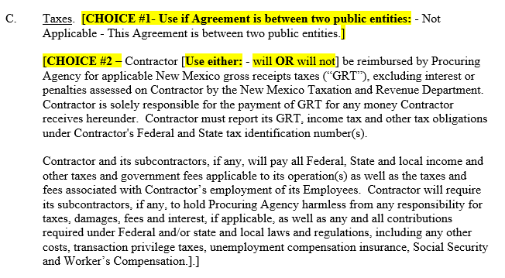
Article 3 Compensation C. Taxes – Template and Guidance
Choice #1 - Between two Public Entities
  The previous Paragraph B. Payment should also indicate that the Total Compensation amount is excluding New Mexico gross receipts tax
Choice #2
  If New Mexico gross receipts tax was included in B. Payment, select will
  If New Mexico gross receipts tax was excluded in B. Payment, select will not

Slide 35
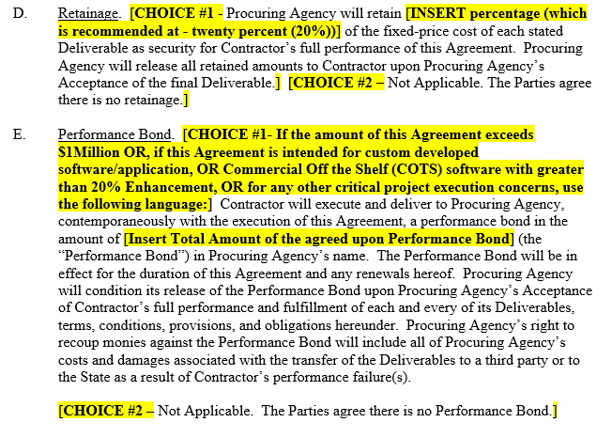
Article 3 D. Retainage – Template and Guidance
As of April 2021, DoIT recommends retainage on contracts in the amount of $500,000 or more that contain fixed price deliverables. A fixed-price deliverable is a single price, regardless of how many actual hours are spent, and is payable when work is delivered and accepted. Retainage may be released deliverable by deliverable after a sufficient period of time, e.g. after 60-90 days, or most effectively and recommended by DoIT, at the completion of all deliverables in the SOW.
Retainage is not required on deliverables that are time and materials-based, which is a deliverable invoiced by the vendor monthly for a number of hours worked at a specific hourly rate. Examples include maintenance and support services or staff augmentation based on an hourly rate.
Contracts over $500K that include a mix of both fixed-price and time and materials deliverables should consider applying retainage to fixed-price deliverables only.

Slide 36
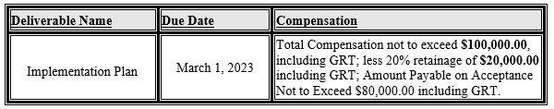
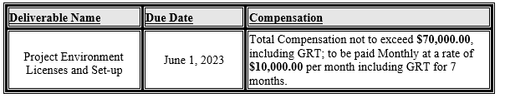
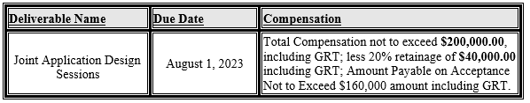
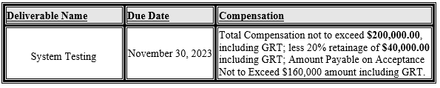
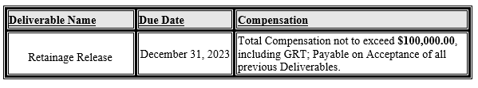
Article 3.D. Retainage - Example
Total Compensation | Retainage Amount | Payable on Acceptance
$100,000 | $20,000 | $80,000
$70,000 | N/A | $70,000
$200,000 | $40,000 | $160,000
$200,000 | $40,000 | $160,000
TOTAL $570,000 | TOTAL $100,000 | TOTAL $470,000

Slide 37
Article 3.E. Performance Bond – Template and Guidance
Choose to use a Performance Bond when
the amount of the Agreement exceeds $1 Million OR,
if the Agreement is for a custom developed software/application, OR
if the Agreement is for Commercial Off the Shelf (COTS) software with greater than 20% Enhancement, OR
for any other critical project execution concerns.

Slide 38
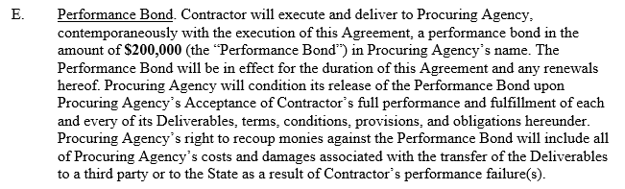
Performance Bond - Example
Choice 1 – Performance Bond – Example

Slide 39
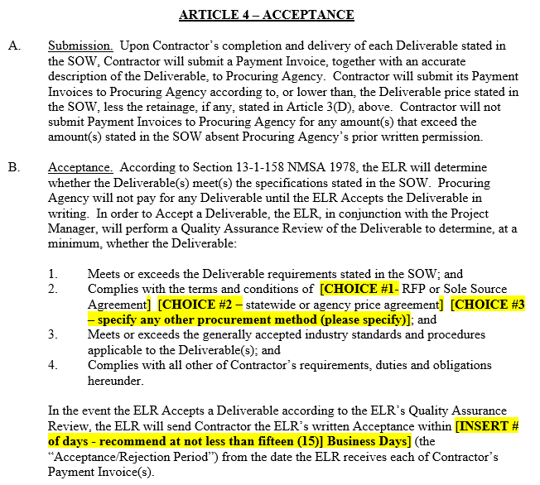
Article 4 - Acceptance – Template and Guidance
Acceptance/Rejection Period
Please be aware of the Project Manager’s role and the ELR’s role regarding the acceptance and rejection of the Deliverables in the Contract.
In the event the ELR Accepts a Deliverable according to the ELR’s Quality Assurance Review, the ELR will send Contractor the ELR’s written Acceptance within fifteen (15) Business Days (the “Acceptance/Rejection Period”) from the date the ELR receives each of Contractor’s Payment Invoice(s).

Slide 40
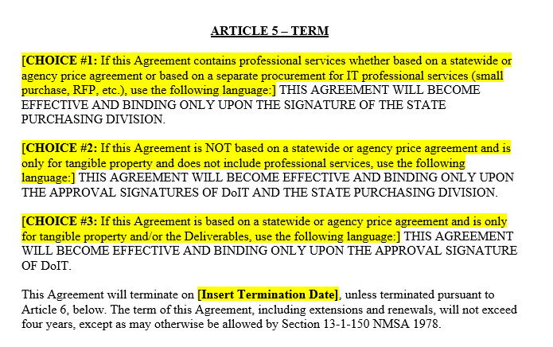
Article 5 – Term –Template and Guidance
Agency will make the selection of Choice, 1, 2 or 3.
Choice 1 is the most common selection, since EPMO primarily reviews IT Professional Services.
The termination date…
  should be a specific day and
  should not be before the last due date of any deliverables in Exhibit A –Scope of Work
  should not be a duration of time, e.g. a “one-year time period”

Slide 41
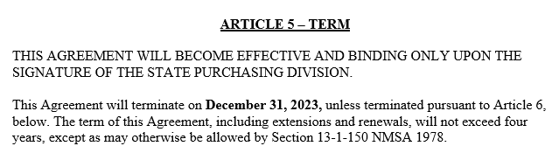
Article 5 – Term – Examples
Choice 1 – Contains any IT Professional Service regardless of Procurement Method.

Slide 42
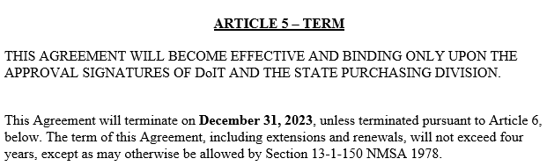
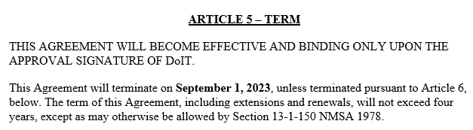
Article 5 – Term – Examples
Choice 2 - For tangible property, NOT based on a statewide or agency price agreement.
Choice 3 - For tangible property based on a Statewide or agency price agreement.

Slide 43
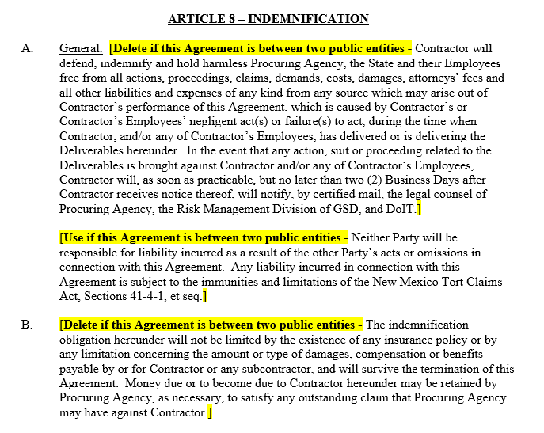
Article 8 – Indemnification – Template and Guidance
Agency will choose if the agreement is between two public entities. Most agreements are NOT between two public agencies therefore the first and third paragraph will be used most often.
This article is often contested/modified by the Contractor however it is required and should not be altered.

Slide 44
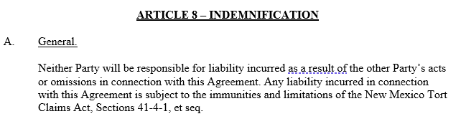
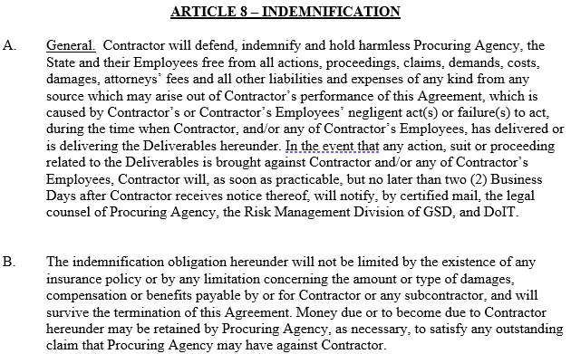
Article 8 – Indemnification – Examples
Between Two Public Entities
NOT Between Two Public Entities

Slide 45
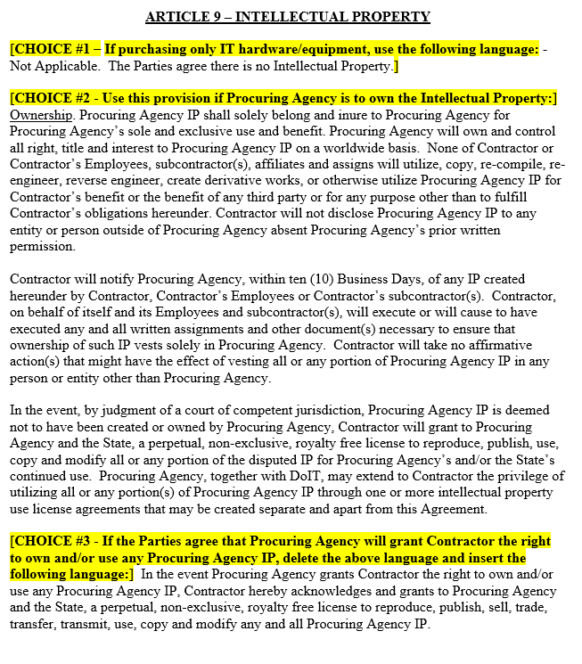
Article 9 - Intellectual Property - Template and Guidance
Intellectual Property is any work or invention that is the result of creativity, to which one has rights and for which one may apply for a patent, copyright, trademark, etc.
All IP referenced in the agreement is considered “Procuring Agency IP”.
This article guarantees that a perpetual license to reproduce, publish, use, copy, and modify all Procuring Agency IP created as a result of this agreement, regardless of who created it.
Examples of IP - Training Materials, System Architecture and Design Plans, Documents and Reports

Slide 46

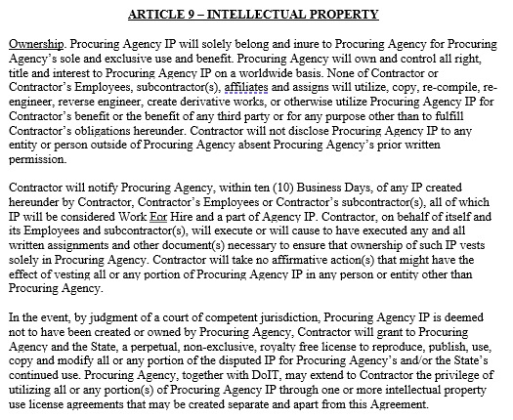
Article 9 - Intellectual Property - Example
CHOICE 1 - If there is no Intellectual Property
CHOICE 2 - If Procuring Agency is to own the Intellectual Property

Slide 47
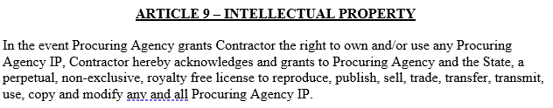
Article 9 - Intellectual Property - Example
CHOICE 3 - If Procuring Agency will grant Contractor the right to own and/or use any Procuring Agency IP

Slide 48
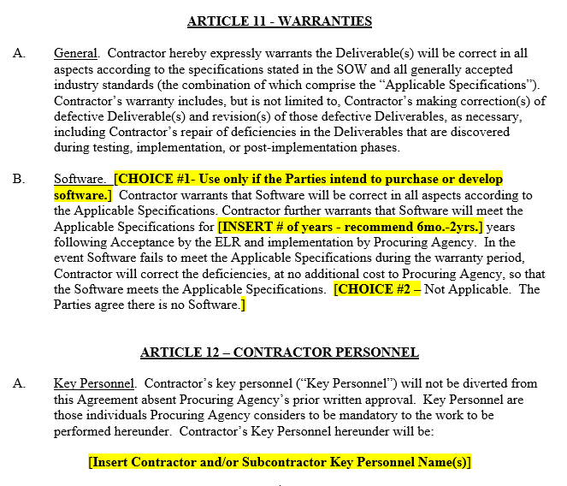
Article 11 - Warranties – Template and Guidance
Software Warranty – If Software is being purchased/developed through this agreement, then the number of years that the software should meet “Applicable Specifications” must be identified.
Applicable Specifications are a combination of the specifications identified in the Scope of Work and generally accepted industry standards. Any defects to the software should be addressed during this warranty period.

Slide 49
Article 12 - Contractor Personnel – Template and Guidance
Agencies should include the Name and Title of the key personnel working on the Project.
If a Statewide Price Agreement is being used the key personnel should include the name, IT Professional Services Category and experience level that corresponds to those attributes listed on the statewide price agreement’s cost schedule.
This information is used to validate the Total Compensation amount listed for each deliverable in the Scope of Work.

Slide 50
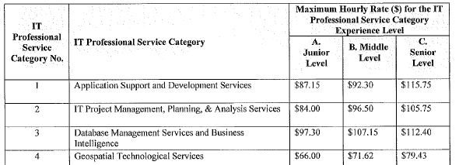
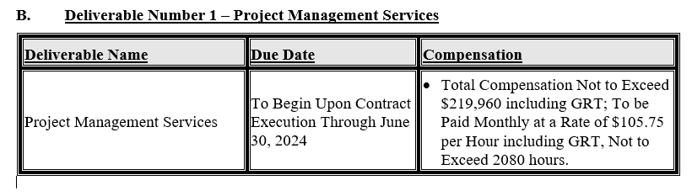
Article 12 - Contractor Personnel – Examples
Don Canard, IT Project Management, Planning and Support Services, Senior

Slide 51

Article 24 - Records and Audit and Survival – Template and Guidance
Please consider the protections offered to the Procuring Agency in this article.
The record retention duration should align with the type, size (in $$$ amount) and scope of the project, internal record retention policies and should consider the period an audit is reasonably anticipated or required.

Slide 52

Article 24 – Survival – Template, Guidance and Examples
Please list any other agreements, promises, or warranties, that are related to this agreement.

Slide 53

Additional Articles
Procuring Agencies may include additional Articles. These are often based on Federal guidance/requirements or other internal or agency specific requirements policies.
Agencies that have additional articles include Human Services Department (HSD), Children, Youth and Families Department (CYFD) , Early Childhood Education and Care Department (ECECD) and Taxation and Revenue Department (Tax and Rev).
Additional articles include those related to Debarment and Suspension, Criminal and Civil Sanctions, Inspection, Federal Partner Requirements and other topics.
Similar to any other change(s) to the terms and conditions, Additional Articles must be identified in a deviation memo addressed from the Procuring Agency Office of General Counsel (OGC) or equivalent to DoIT’s Office of General counsel and EPMO Division Director.

Slide 54

Contract Signature Pages - Examples
Some of the areas in the Signature Pages that have recently changed are:
  As of July 1, 2021 the formerly known “CRS ID Number” is now referred to by TRD, as the Business Tax Identification Number or BTIN ID Number.
  Also, in the last signature line, previous contract versions included the Contract Review Bureau. At their request, DOIT has changed the signature line to read the State Purchasing Division, the Contract Review Bureau’s Division.

Slide 55
Signature Pages DocuSign Routing
The routing template within DocuSign for contract templates will route the procurement to the Contracts Review Bureau, DoIT EPMO and DoIT legal for a preliminary approval.
That routing will occur independently of the routing signatures entered by an Agency, prior to the contract being routed to the DoIT Cabinet Secretary and State CIO.
Once DoIT signature is completed, the final signature, which makes the contract executable, is provided by CRB.

Slide 56

Exhibit A – Scope Of Work – Purpose - Template and Guidance
  The Purpose Statement
  should begin strictly with “The purpose of this contract, including its goals and objectives are to…”
  should be brief - one paragraph only (two to four sentences long) but detailed enough to understand the reason/need/intended result for the contract.
  should NOT include additional lists or information not specific to the purpose of the agreement. If it is general work or responsibilities of the Contractor, they should be included as tasks/subtasks in one or more of the Deliverables.
  should strictly use the terms “Procuring Agency” or “Contractor”, NOT the specific name/acronym of the Agency or Contractor.
  will be used as the contract description in the database that EPMO uses to record contract reviews.
If the work is part of a certified project, the Certified Project Name should be included. The project name is the one used when requesting C2 appropriations and/or the project’s PCC certification documents.

Slide 57

Exhibit A – Scope of Work – Purpose Example

Slide 58

Exhibit A – Scope of Work – Deliverables Template and Guidance
Exhibit A – Scope of Work - Section II includes a statement that prefaces the deliverable tables that is a required part of the contract template,.
The highlighted text are directions to the contract author only and should be deleted.

Slide 59
Contract Review: Fixed Price % Time and Materials
Most contracts received by EPMO are fixed price contracts, a few are time and materials based.
A fixed price deliverable has a set price and the Contractor is accountable for completing the deliverable for the agreed amount by a specific date. A specific due date (not a duration of services) should be used for fixed price deliverables.
  Example - Total Compensation Amount Not to Exceed $XXXXX including/excluding GRT to be paid in full upon review and acceptance.
A time and materials (T&M) deliverable is paid incrementally at a specific rate. The compensation should provide the frequency of payment and the rate each payment is based. A duration of services can be used for the deliverable due date.
  Example - Total Compensation Amount Not to Exceed $XXXXX including/excluding GRT, To Be Paid Monthly at $XXXXX/hour, Total Hours Not to Exceed XXXXX.
  Example - Total Compensation Amount Not to Exceed $XXXXX including/excluding GRT, to be paid monthly at $XXXXX/per month not to exceed 12 months.

Slide 60

Contract Review: Deliverables Template

Slide 61

Contract Review: Deliverables Name
Deliverable Name – the name listed above the table should match the name listed in the table. Make sure that the deliverable is correctly numbered or lettered.

Slide 62

Contract Review: Due Date
Insert the actual date this deliverable is due.
If an actual date is not available, enter a no later than date.
A duration of time is acceptable if services are to be performed and paid incrementally.
NOTE - An Amendment to the contract is not required if the change to any deliverable Due Date does not require an extension of Article 5 termination date.
  This provides the Agency and Contractor the opportunity to mutual agree and manage the performance of the contract.

Slide 63

Contract Review: Compensation
The Total Compensation of all Deliverables will be added and verified against Article 3, B. Payment by both EPMO and GSD/CRB.
The inclusion/exclusion of GRT should align with Article 3, C. Taxes.
Retainage should align with Article 3 D. Retainage

Slide 64

Contract Review: Task Item, Sub Tasks and Description
Task Item, Sub Tasks and Description

